Slide 1
DATS 6103 Individual Project 2 Video Game Sales 2019 Spring
Hao Ning
hning@gwmail.gwu.edu

Slide 2
Project Overview
Source of data
Data import and cleaning
Data visualization and analysis
Number of game released per year
Total sales by region, Sales by platform
Game genre released by year
Number of game by genre, market share of game genre
Top 10 publisher and market share of publisher
Comparison of top 10 platform vs genre
Comparison of genre sales vs region in absolute and percentage
Top 5 games by region
Summary

Slide 3
Source of Data
Source
Kaggle: Video Game Sales
https://www.kaggle.com/kendallgillies/video-game-sales-and-ratings
The data set has 17k rows and 15 columns
Contains a list of video games with sales greater than 100,000 copies. It was generated by a scrape of vgchartz.com, as of Jan,2017
the website changed a lot now and some information is not available (such as game genre is not available in the table), use the data from kaggle

Slide 4
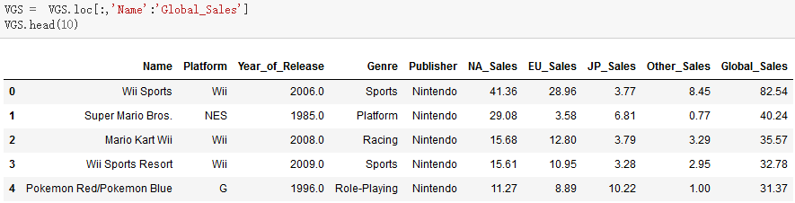
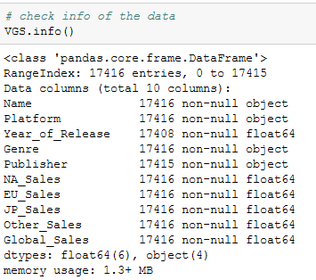
Data Import
Import packages
pandas, numpy, os, matplotlib, seaborn
Read CSV and .loc needed entries
Quick overview of dataframe using info()
data structure
data type
columns and entries

Slide 5
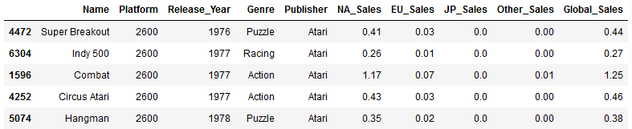
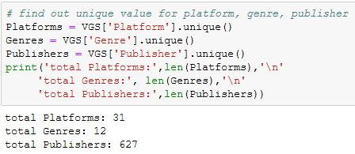
Data Cleaning
Dropna()
Rename column, change type
'Year_of_Release' to 'Release_Year'
Change type from float64 to int64
Check max and min year
Sort by 'Release_Year'
Find unique values

Slide 6
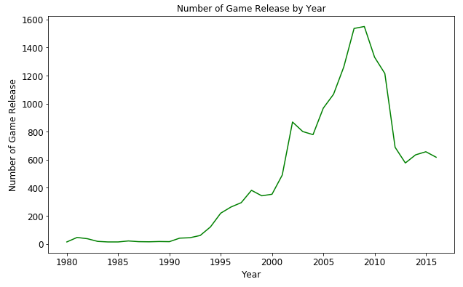
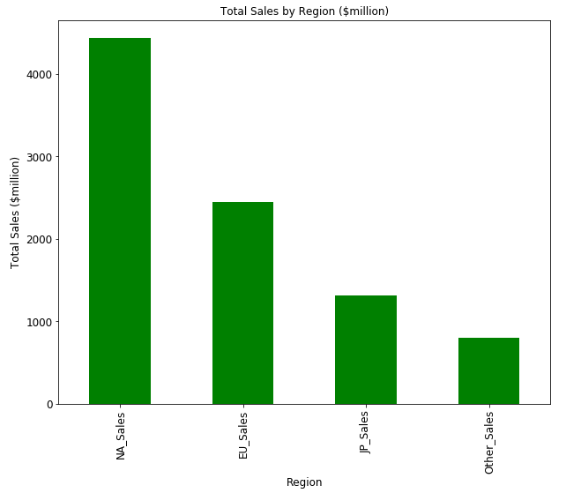
Game Released & Sales by Region
Use groupby('Release_Year') & count()
Use sum() to get total sales

Slide 7
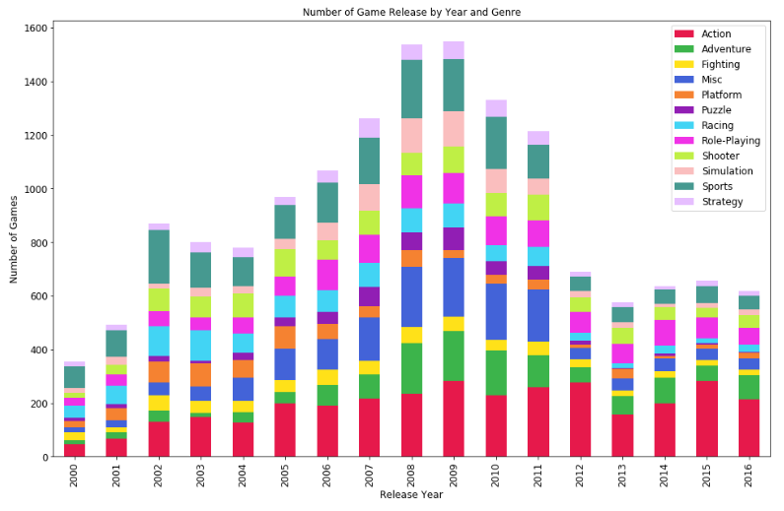
Game Genre Released by Year
Groupby(['Release_Year','Genre'])
['Release_Year'].count()
Release year of 2000 to 2016
Stacked bar plot
Key Findings
sports, simulation and miscellaneous games showed decrease after the 'peak era'(2008-2009)

Slide 8
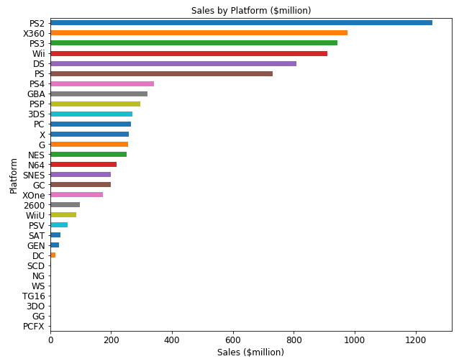
Sales by Platform
Groupby('Platform') & sum() on Global_Sales
Plot as horizontal bar
Sales by platform
PS2
X360
PS3
Wii
DS
PS
GBA
... ...

Slide 9
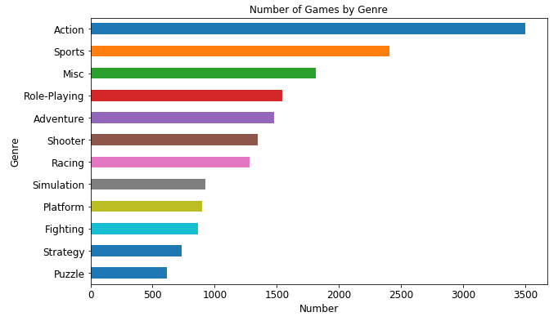
Number of Game by Genre
Groupby('Genre') & count()
Action
Sports
Misc
Role-Playing
Shooter
Adventure
Racing
Platform
Simulation
Fighting
Strategy
Puzzle

Slide 10
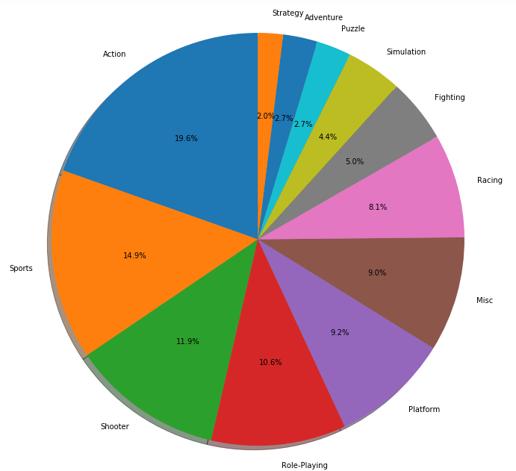
Market Share of Game Genre
Groupby('Genre').sum()['Global_Sales']
Action
Sports
Shooter
Role-Playing
Platform
Misc
Racing
Fighting
Simulation
Puzzle
Adventure
Strategy

Slide 11
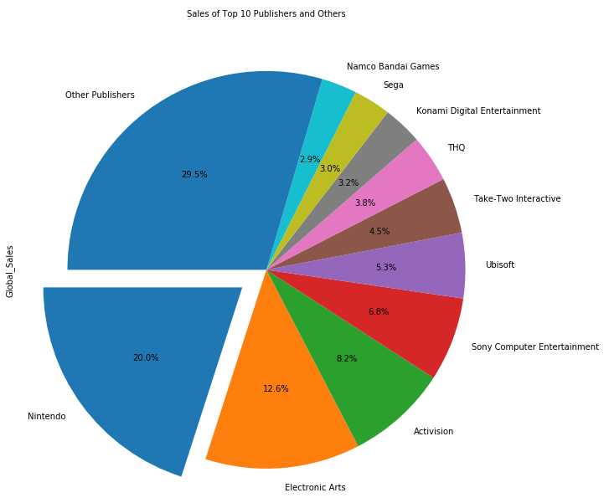
Top 10 Publishers and Market Share
Groupby('Publisher') & sum() on Global_Sales
Sort and get top10
Total of 627 publishers
Market share of top 10 and all other publishers
Calculate sales of other publishers using the rest of rows(other than the top10) from the dataframe
Nintendo is the 'king of publishers'

Slide 12
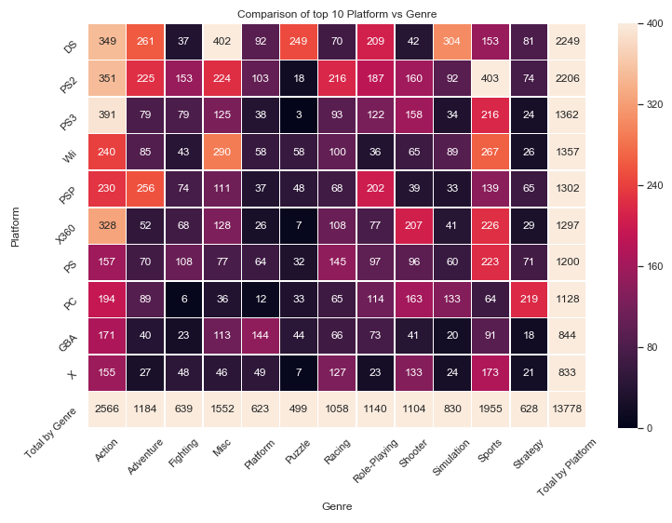
Top10 Platform vs Genre
Use pd.crosstab to get the crosstable of game platform vs genre
Create new column and new row of total games
Total by Platform - row
Total by Genre - column
Plot annotated heatmap using seaborn for clear comparison
DS & PS2 have quite a lot amount of games with different genres
Wii, Xbox360 etc. seems 'specialized'

Slide 13
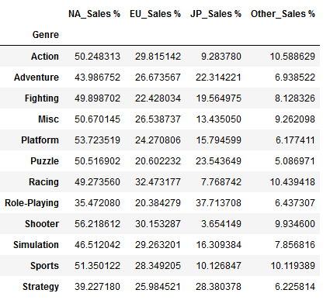
Genre Sales vs Region
Groupby('Genre').sum()
.loc get regions
Calculate region sales percentage
percentage number = region_sales/global_sales * 100
Annotated heatmap in absolute and percentage shown next slides

Slide 14
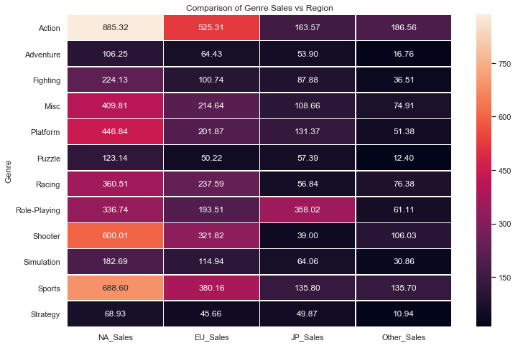
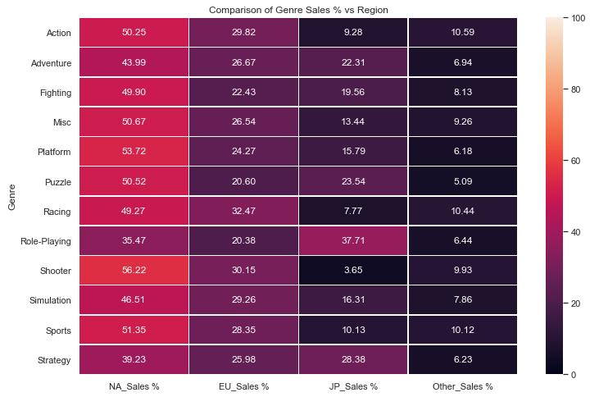

Slide 15
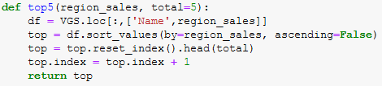
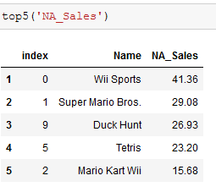
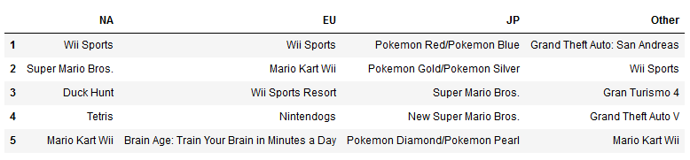
Top 5 Games by Region
Define function
Get top 5 games of different regions
Put together in one dataframe
Does different region have different taste?
NA and EU are similar
JP and other are totally different

Slide 16
Summary
Video game sales data from 1980 to 2016 is studied
Published to github: https://github.com/hning87/DATS-6103-Individual-Project-2
Key findings and conclusions:
Number of game released showed the peak era at 2008 and 2009 followed by some decrease then plateaued
probably due to a saturated market, also the increasing popularity of PC games and mobile games
NA is the largest market, Japan also impressive considering their population, potential in other regions
Platforms sales: PS2, Xbox360, PS3, Wii, DS, etc.
Genres
Most games: Action, Sports, Misc, Role-Playing, Shooter
Most sales: Action, Sports, Shooter, Role-Playing, Platform
Publishers
Nintendo has the dominating market share of 20% among 627 publishers
Top10 Platform & Genre
DS & PS2 have great amount of games in different genres while other platforms are 'specialized'
Genre Sales vs Region
Action, shooter, sports have great popularity in NA
Adventure, role-playing, strategy games have greater share of market in non-NA regions, especially in Japan
Top 5 games at different region
NA & EU kind of similar, other regions are diverse

Slide 17
Thank you!

